Slide 1
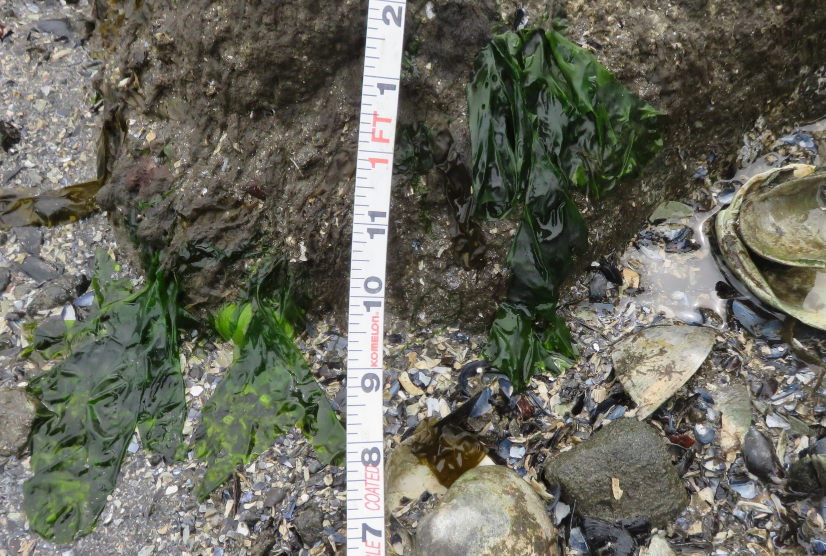
Ulva sp.
Thin grass-green sheets of various shapes and sizes
Found throughout the intertidal zone (except highest points)

Slide 2
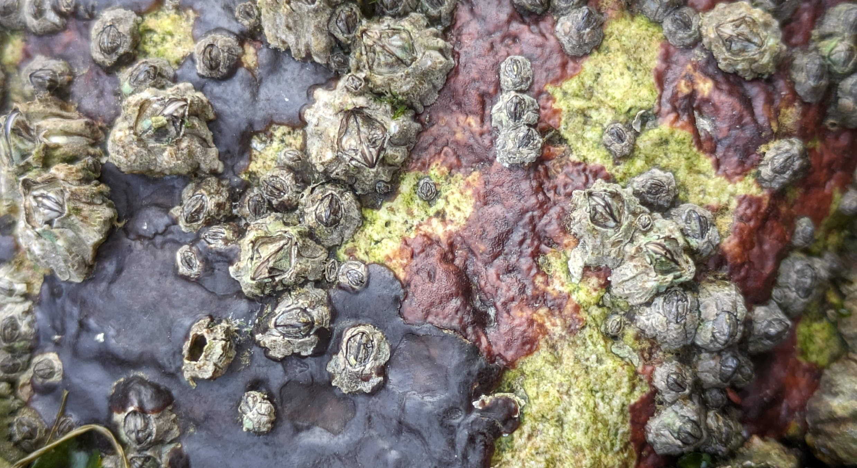
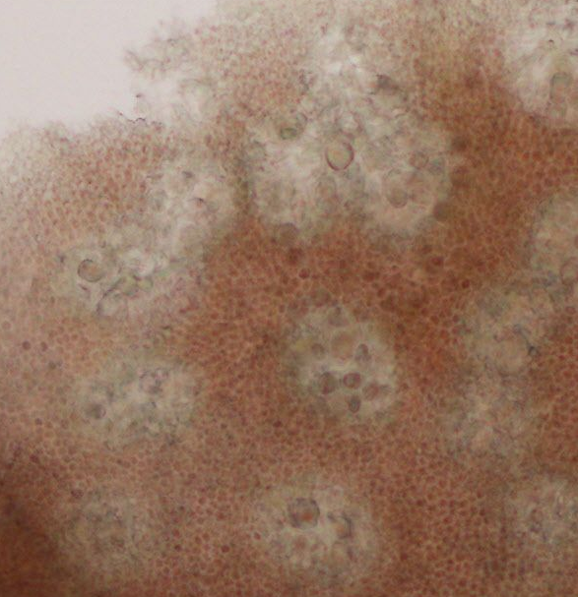
Mastocarpus crustose Hildenbrandia sp.
Red-black “tar spots” on rock
Thick crust visibly raised from rock surface
Crust may have small blades protruding out
Mostly high intertidal, but throughout intertidal zone
Red crust on rock
Thin crust, not visibly raised from rock surface
Found throughout intertidal zone
Hildenbrandia sp. conceptacles under microscope
100 μm

Slide 3
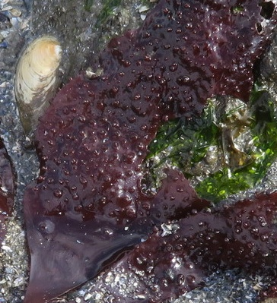
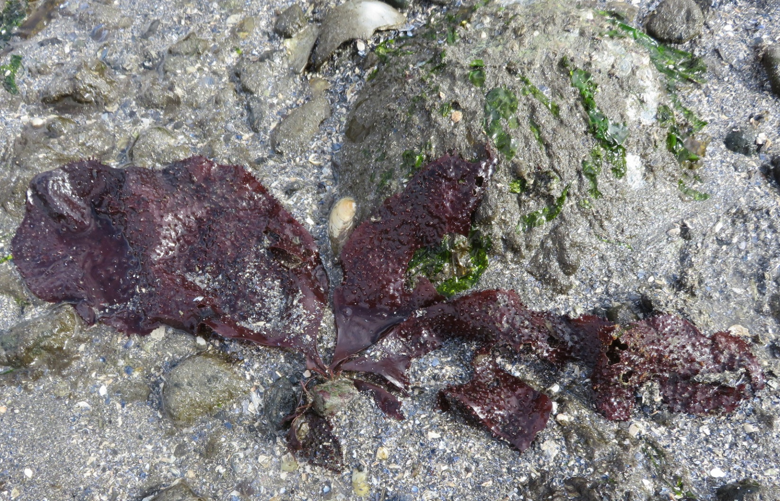
Chondracanthus exasperatus
Rubbery blades covered in bumps
Bright to dark red
Usually >10cm long, up to 100cm
Blades arise in clumps
Low intertidal to subtidal

Slide 4
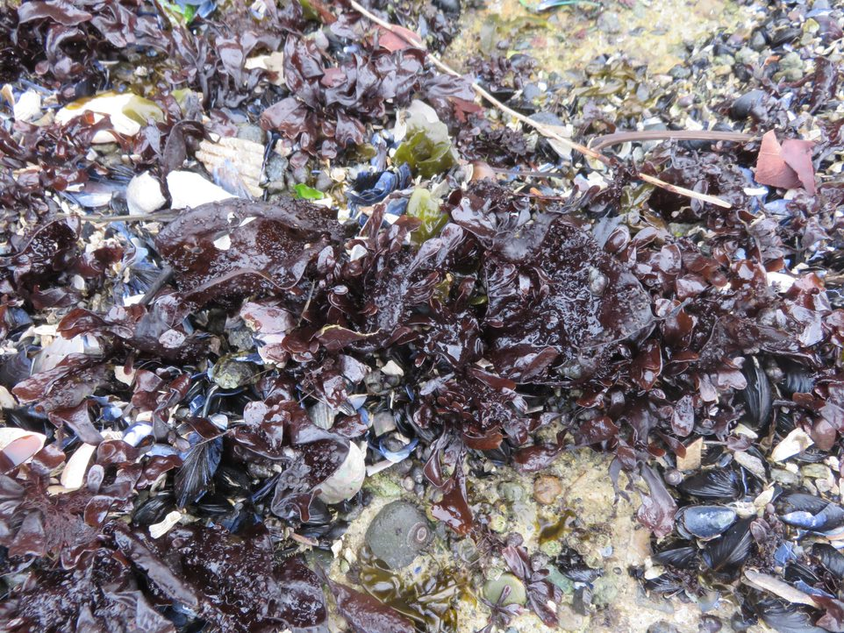
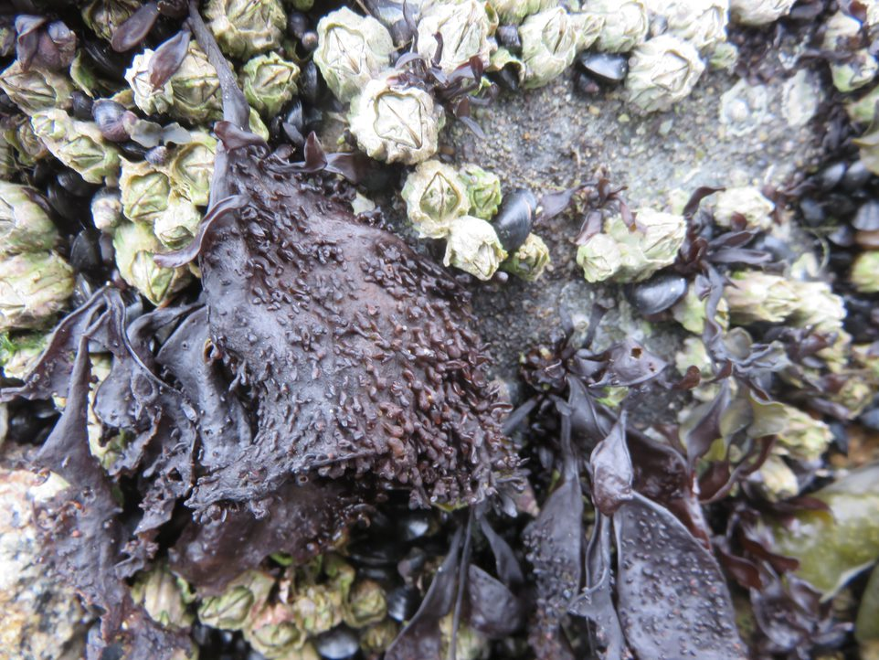
Mastocarpus sp.
Thick rubbery blades covered in bumps
Dark red to almost black
Blades arise in dense clumps
Mostly high intertidal, but throughout intertidal zone

Slide 5
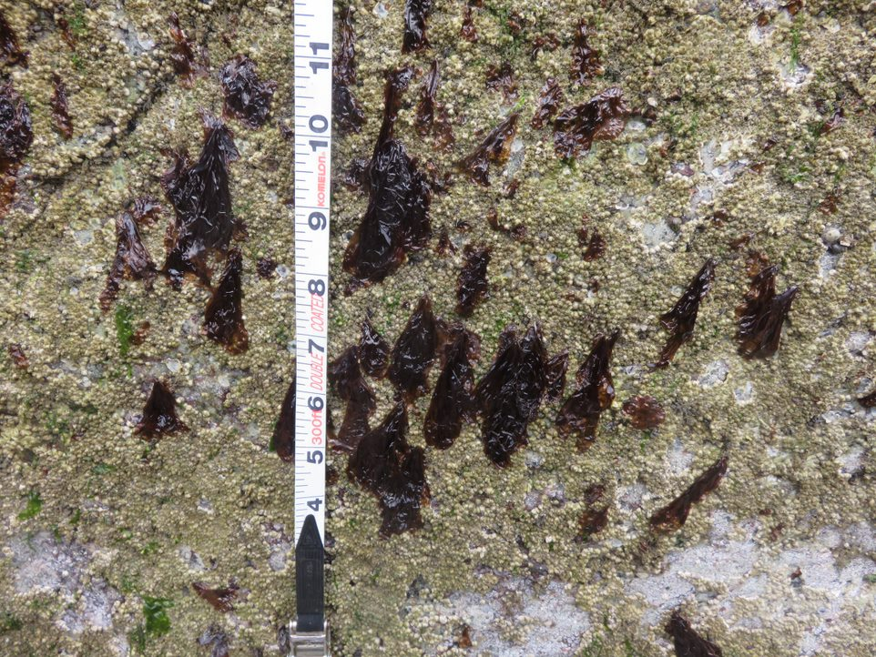
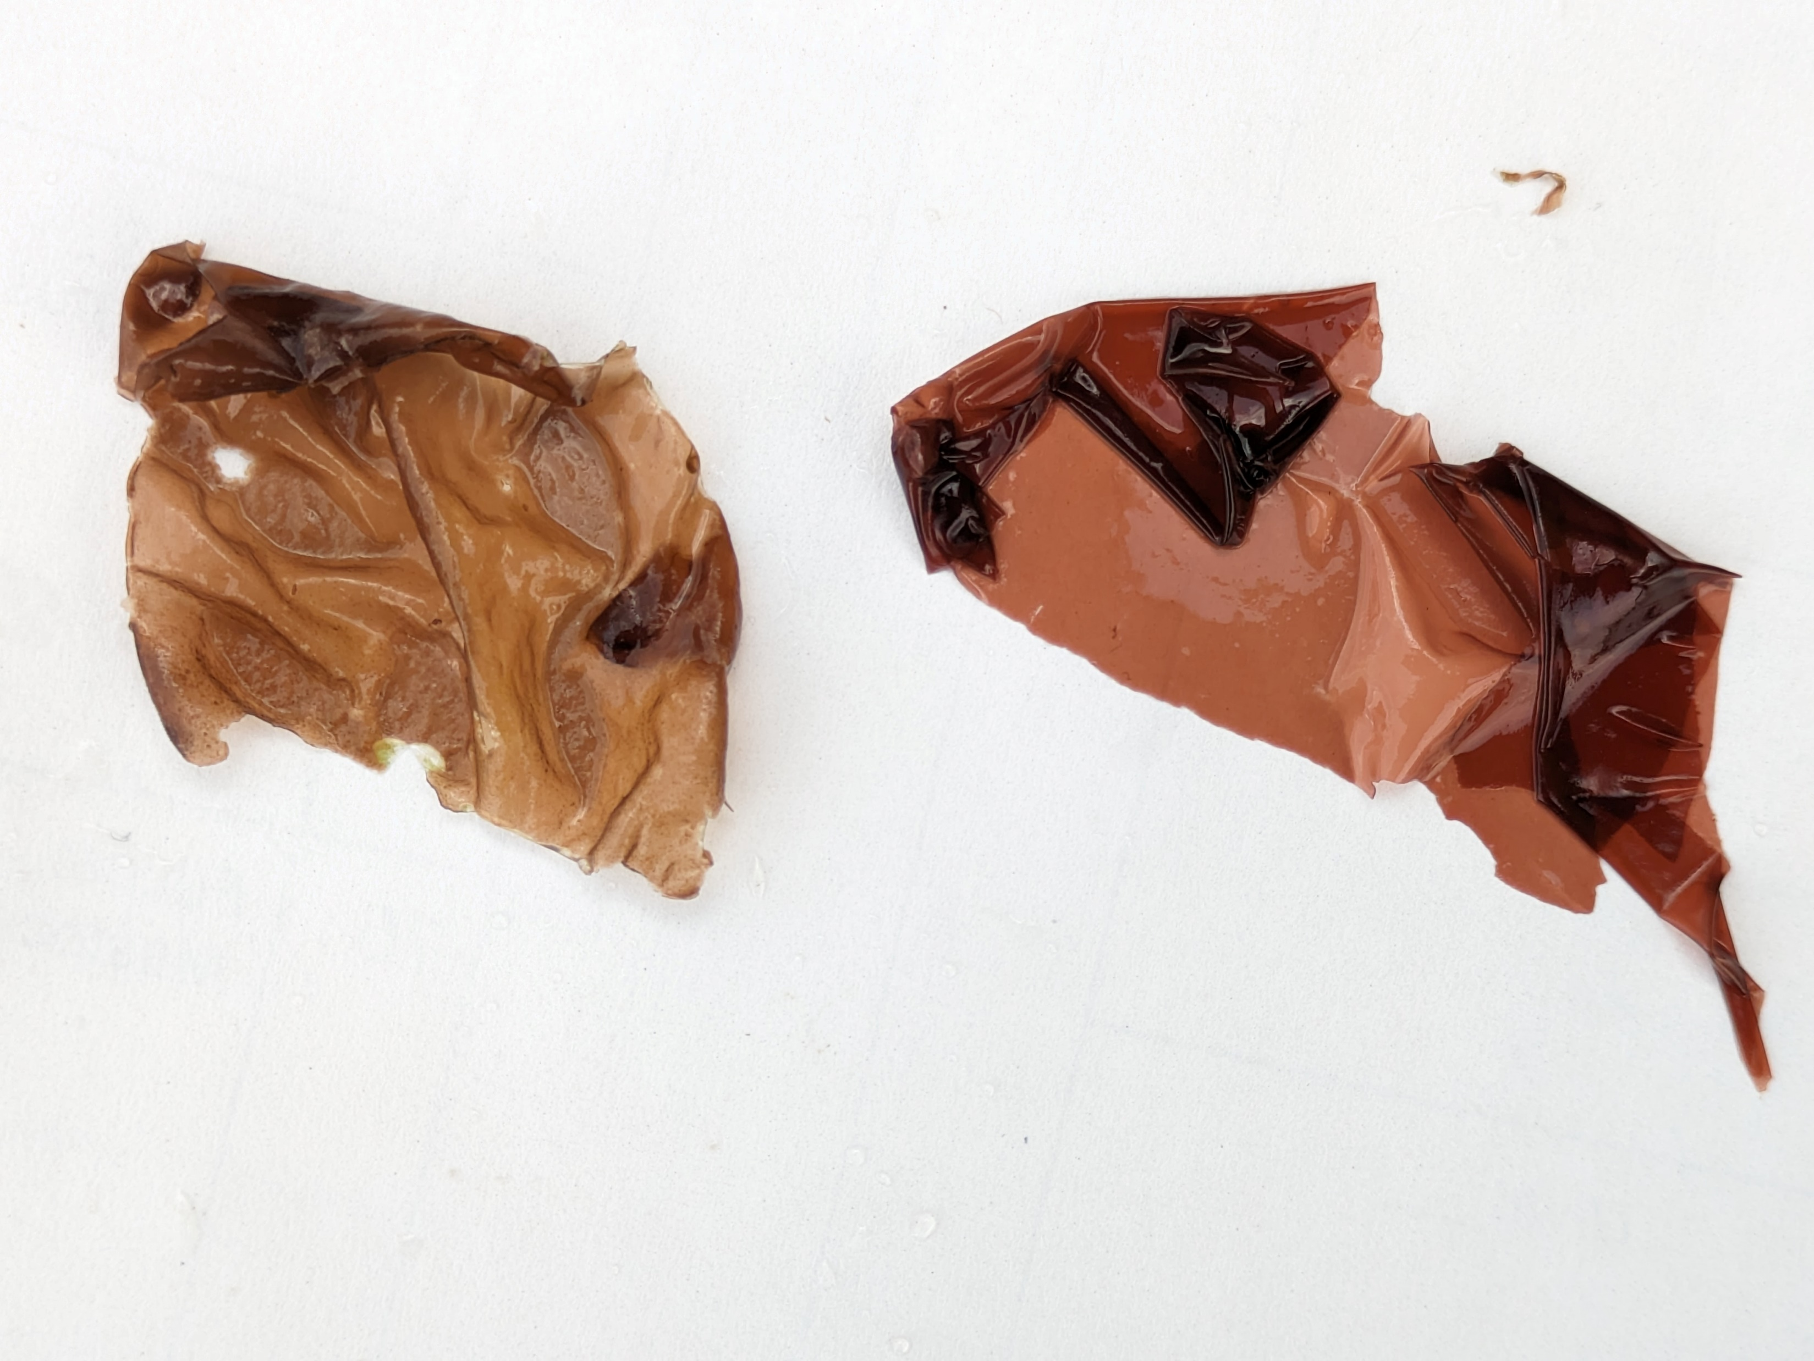
Pyropia sp. Wildemania sp.
Filmy, very thin dark red to black blade
Collapses into clumps out of water
Found in the mid to high intertidal zone, mostly on the upper half of boulders
Filmy, very thin scarlet to wine red blade
Blade longer than wide
Collapses into clumps out of water
Found in the mid to low intertidal zone, mostly on low cobble

Slide 6
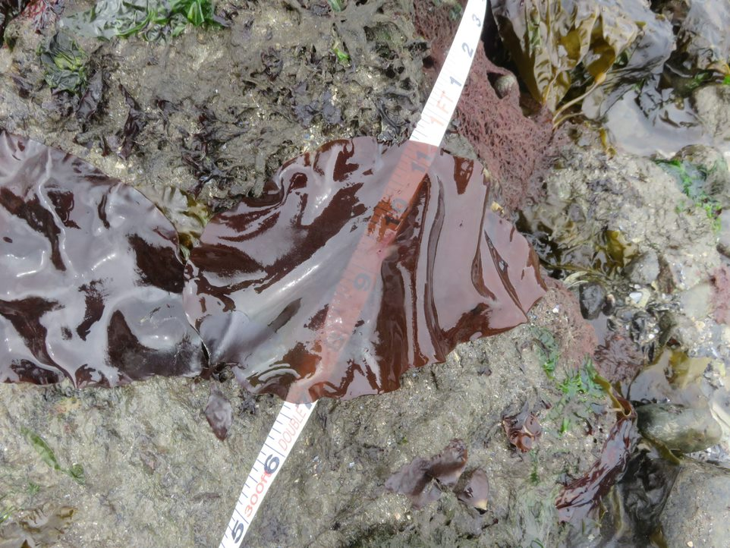
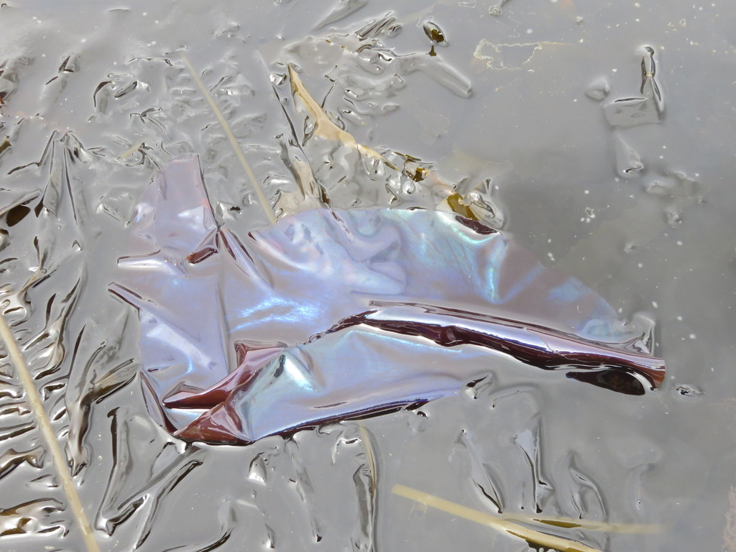
Mazzella splendens
Smooth, red blade
Feels “stretchy”
Iridescent blue underwater
Maintains blade shape out of water
Low intertidal to subtidal

Slide 7
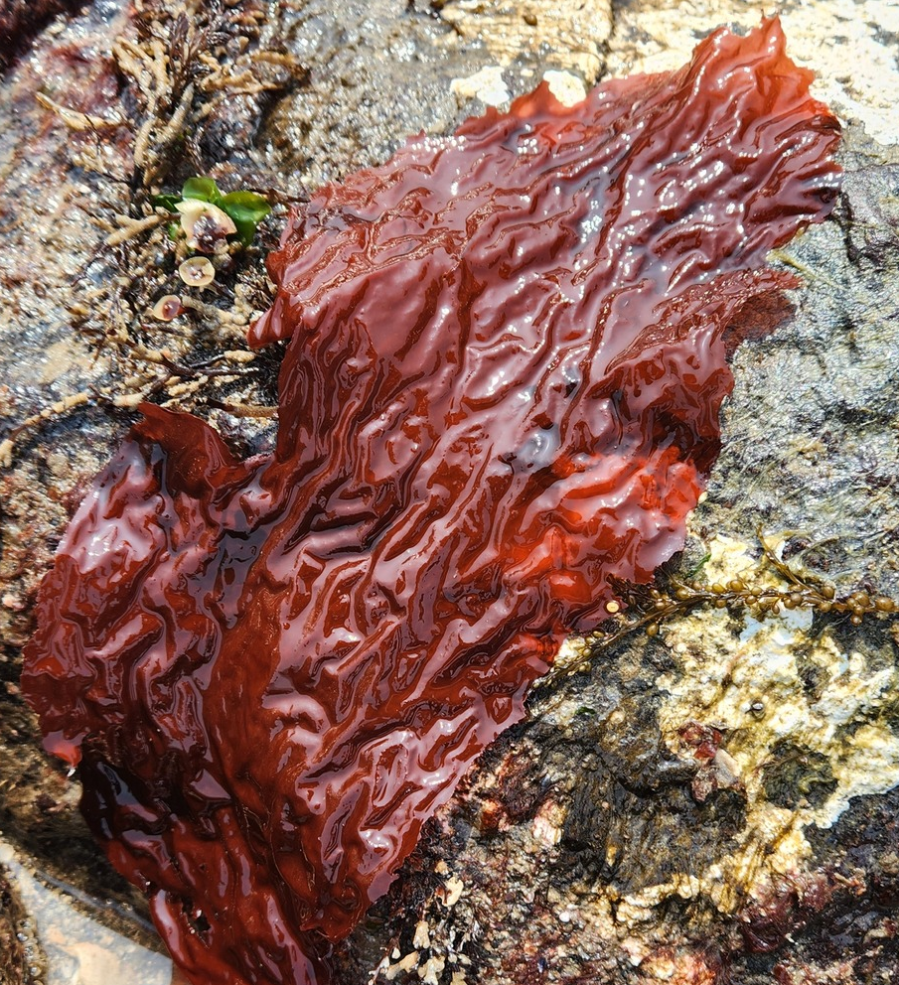
Neodilsea borealis
Thin, wrinkled blades
No veins or holes
Bright red
Low intertidal to subtidal

Slide 8
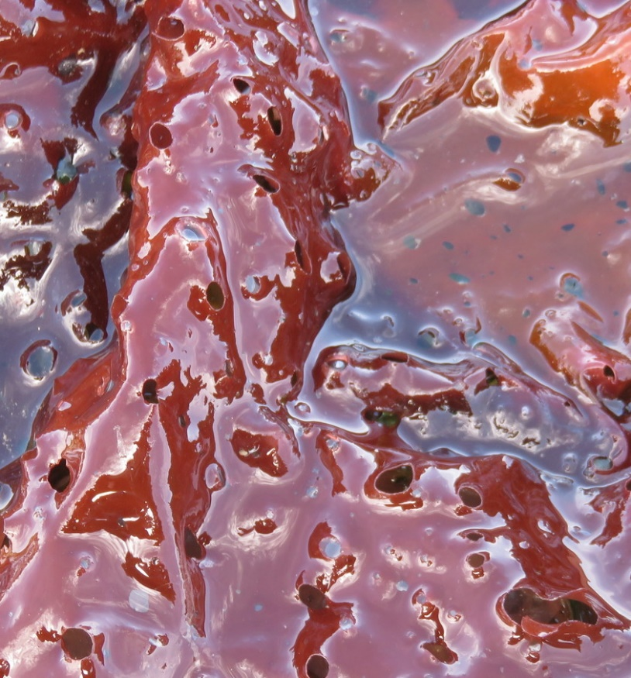
Sparlingia pertusa
Thin blades dotted with round holes
Bright red
Low intertidal to subtidal

Slide 9
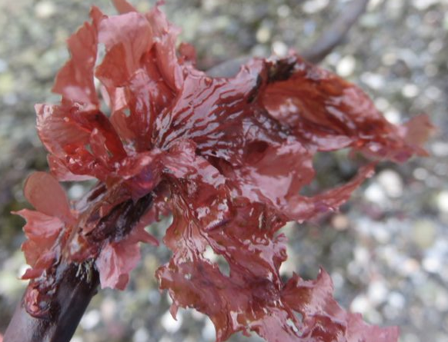
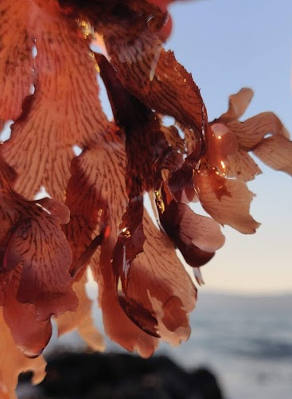
Polyneura latissima
Light red blade with brittle texture
Has visible veins when held up to light (not wrinkles, see p. 9)
Usually <10cm
May grow in clumps
Found in low to mid intertidal

Slide 10
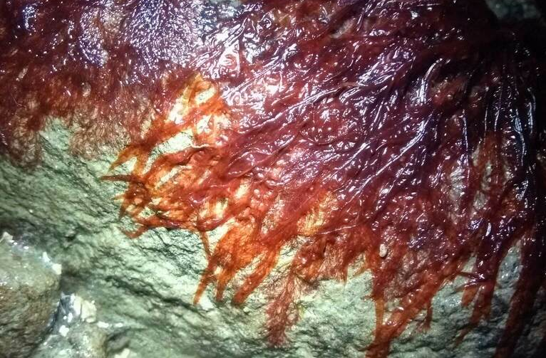
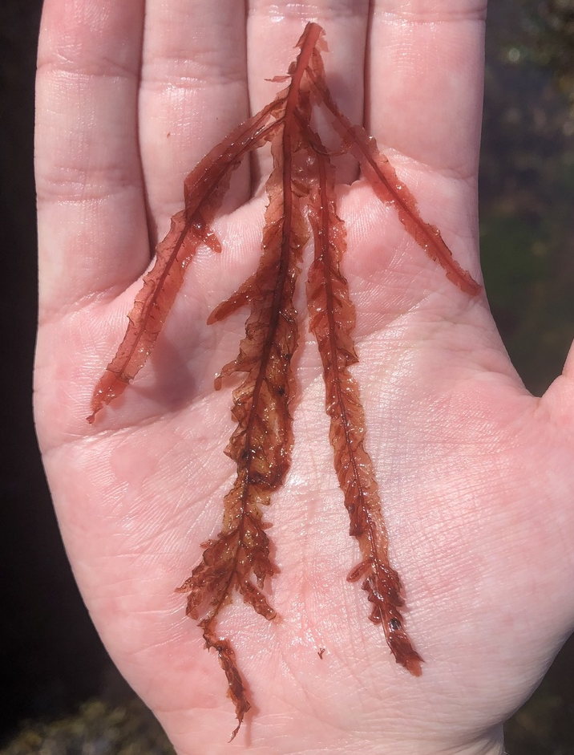
Cumathamnion decipiens
Image Credit: Elliot Porcher
Clumps of narrow, filmy blades with pointed tips
Blades have a translucent midrib that extends to the very tip
Very low intertidal to subtidal

Slide 11
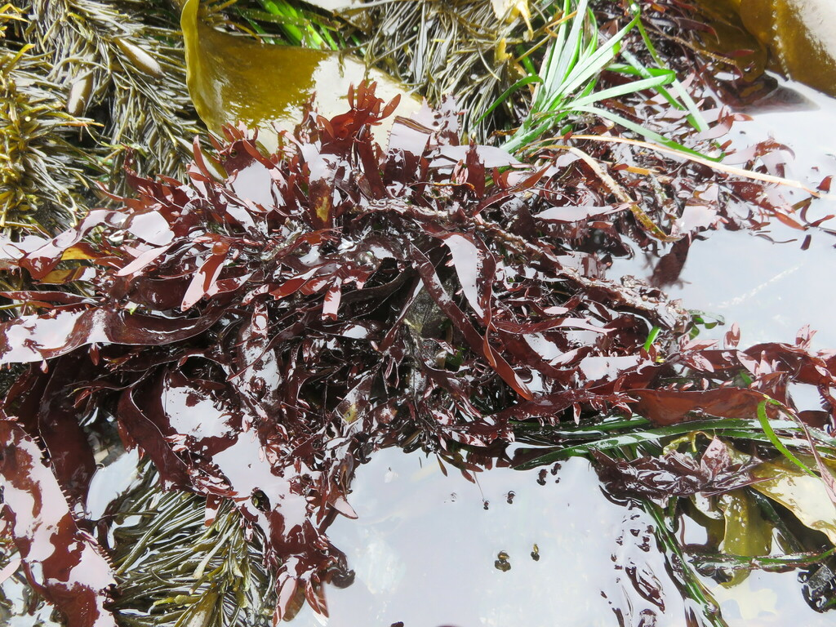
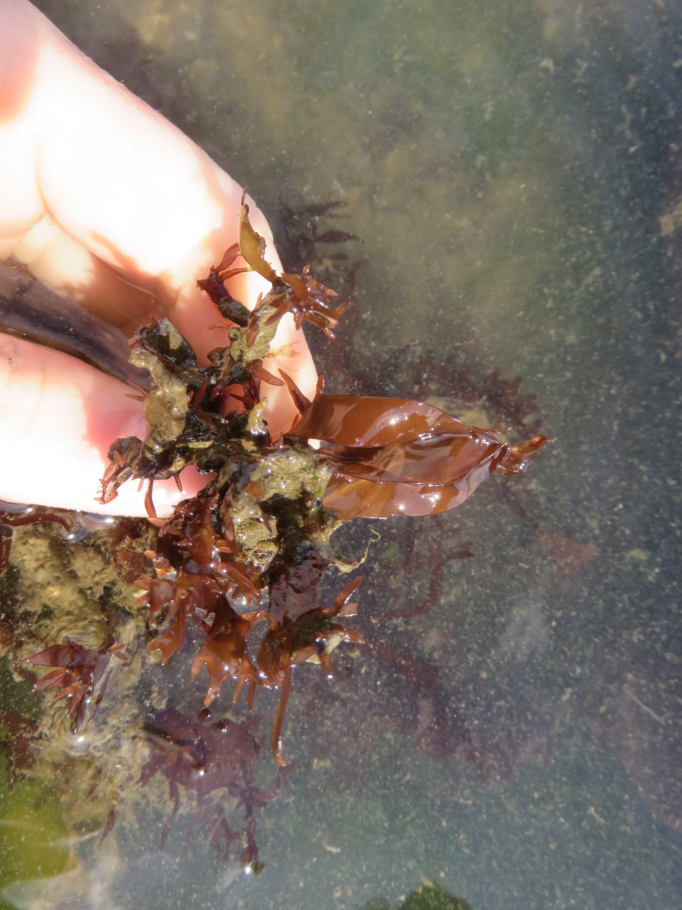
Prionitis sternbergii
Dark red, cartilaginous blades
Often crinkled and curled in clumps
Characteristic bleach smell when damaged
Main blades have numerous flattened bladelets lining the margins
Mid to low intertidal

Slide 12
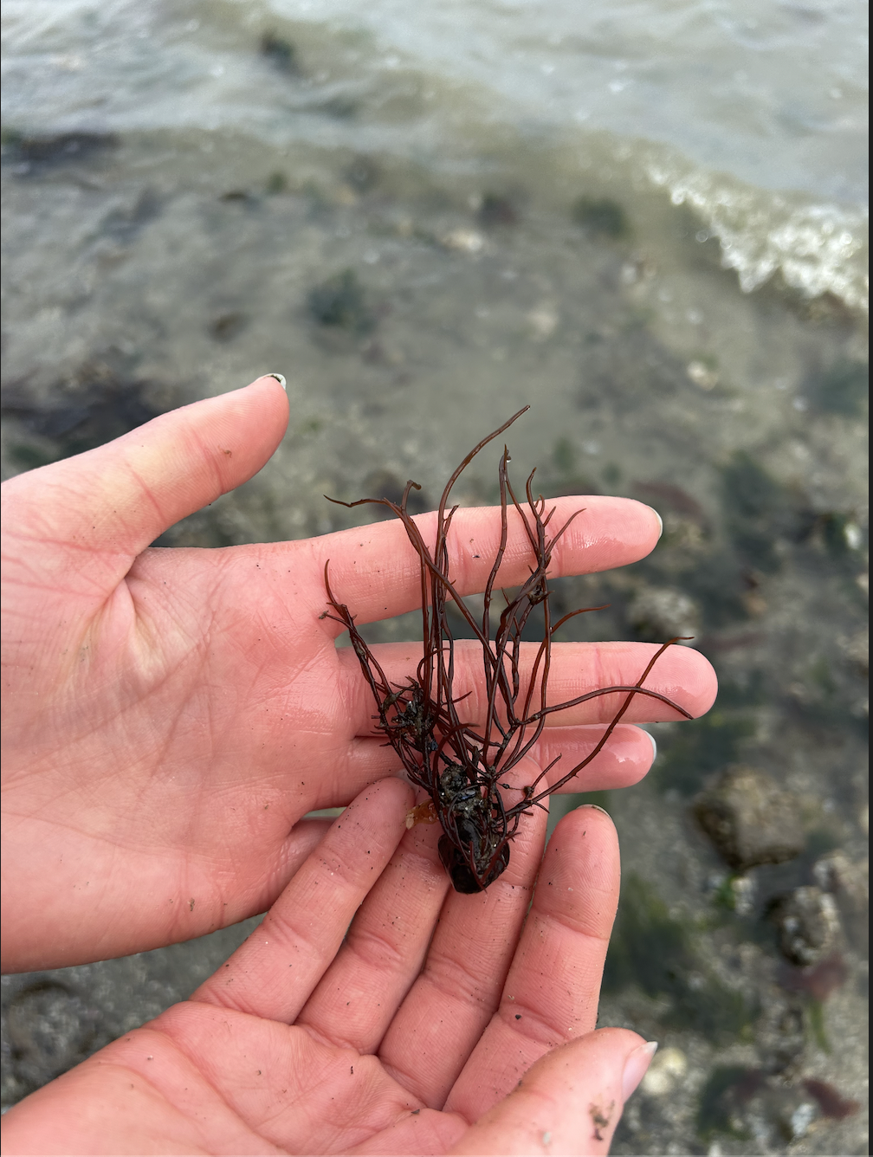
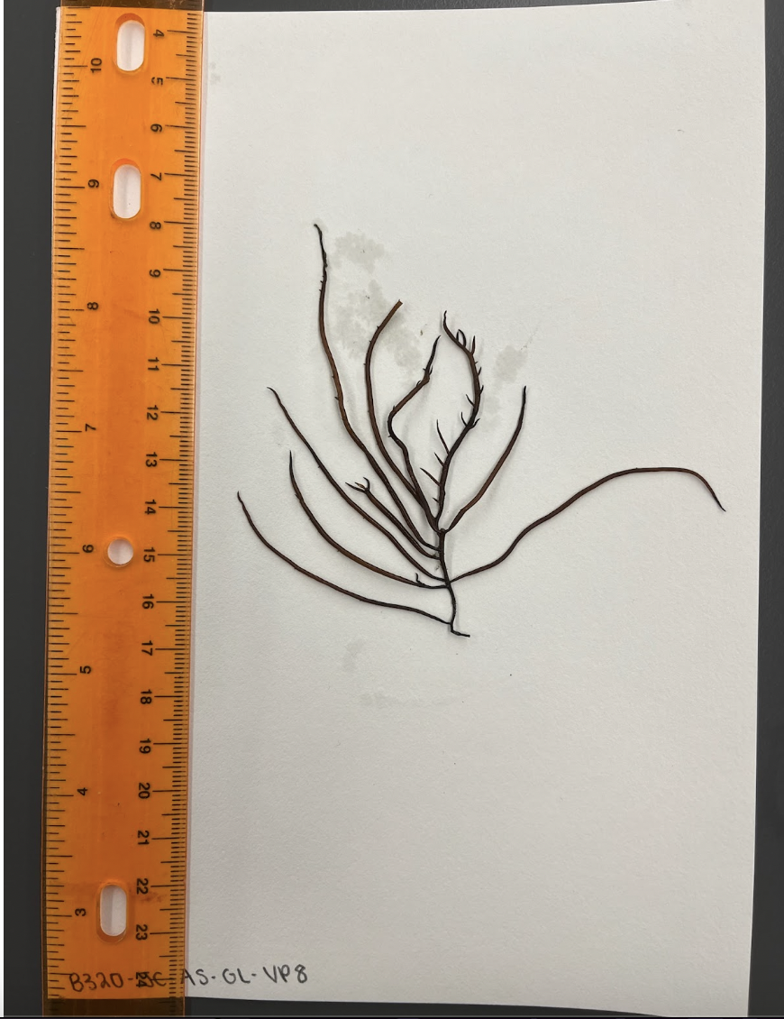
Gracilaria sp.
Credit to anikasantos on iNaturalist
Dark red
Branches do not pinch off near main central branch
Round in cross-section

Slide 13
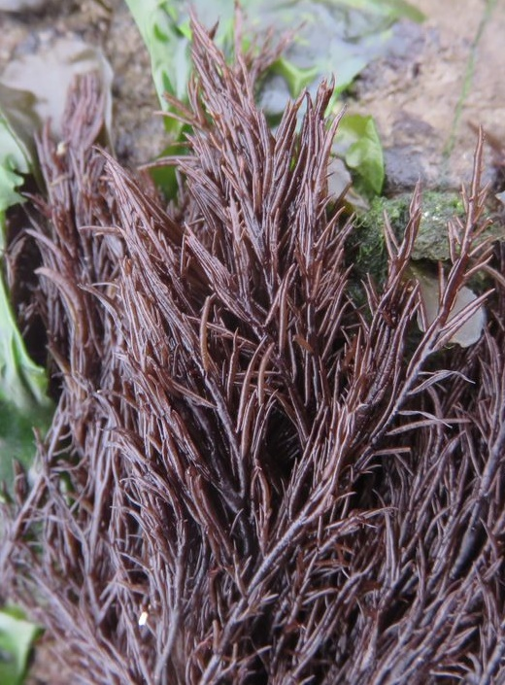
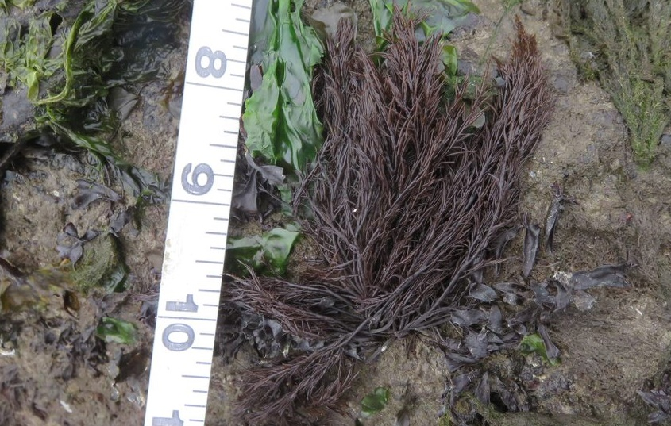
Cryptosiphonia woodii
Dark red branched alga
short branchlets at irregular intervals along branches
Branchlets often pinched where they join the branch
Mid intertidal

Slide 14
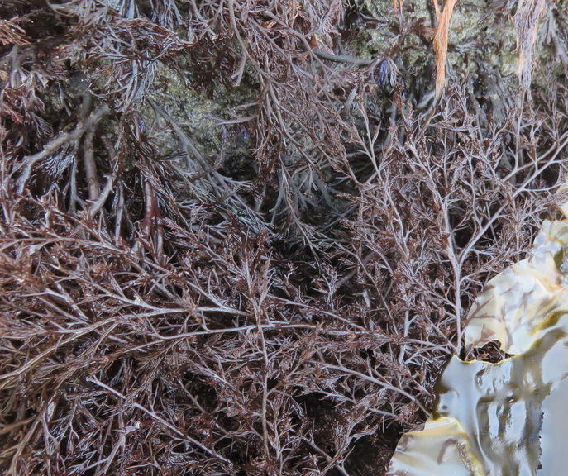
Odonthalia floccosa
Dark red to almost black, branched alga
Alternate branching mostly spread in one plane and grade smoothly into the main branch​
Mid to low intertidal​

Slide 15
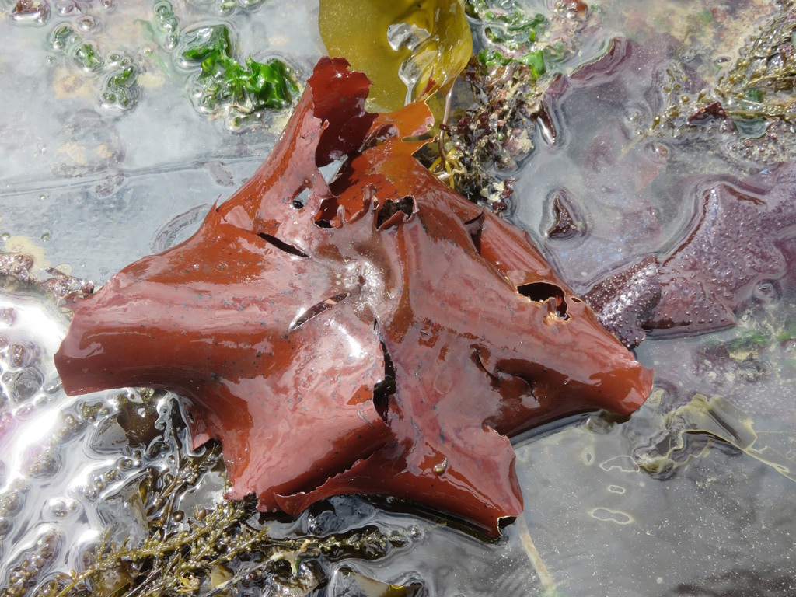
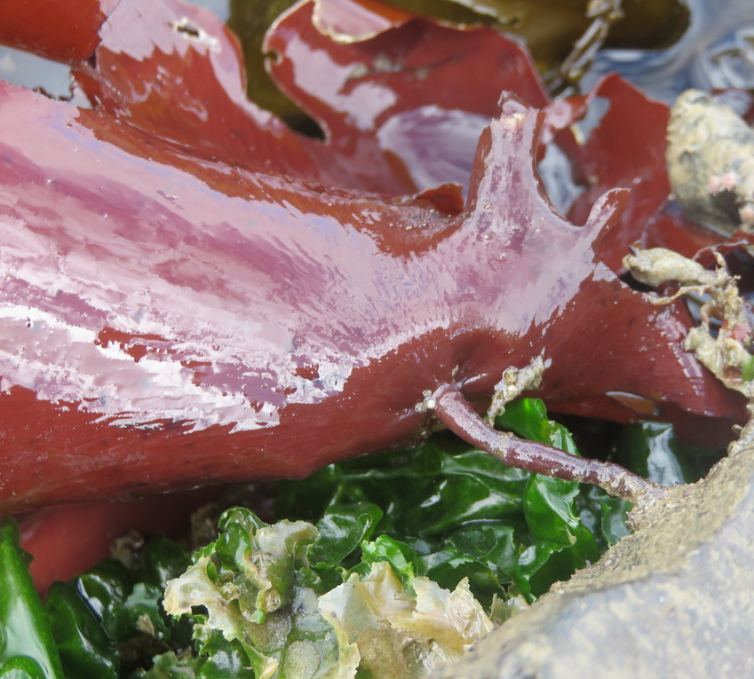
Constantinea subulifera
Orange-red to brown-red, rounded (may be torn) leathery blades
Stipe connects to the center like an umbrella
Very low intertidal to subtidal

Slide 16
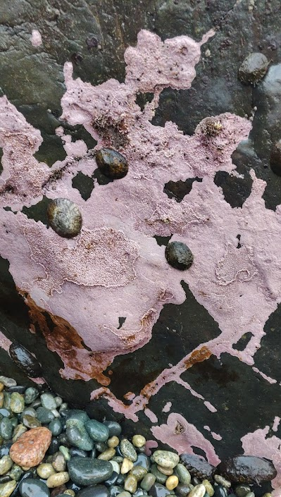
Crustose coralline
Bright pink hard crust on rocks
Very low intertidal to subtidal

Slide 17
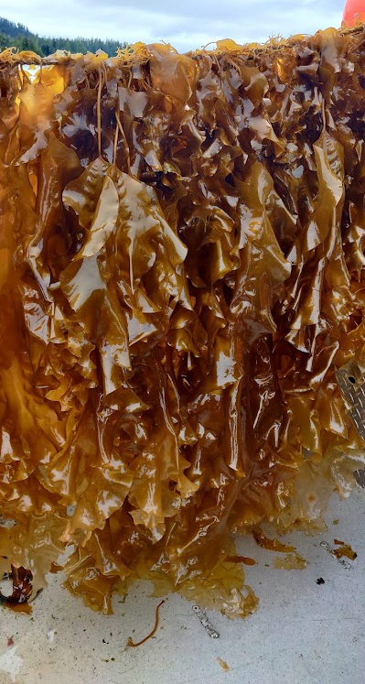
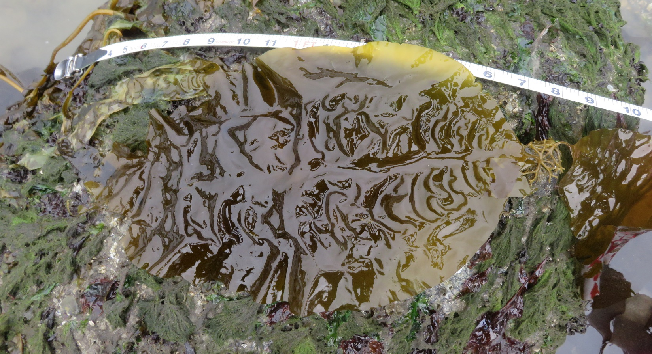
Saccharina latissima
Large brown blade
Two rows of ruffles
Visible holdfast and stipe
No midrib
Mid intertidal to subtidal
Saccharina latissima on a kelp farm

Slide 18
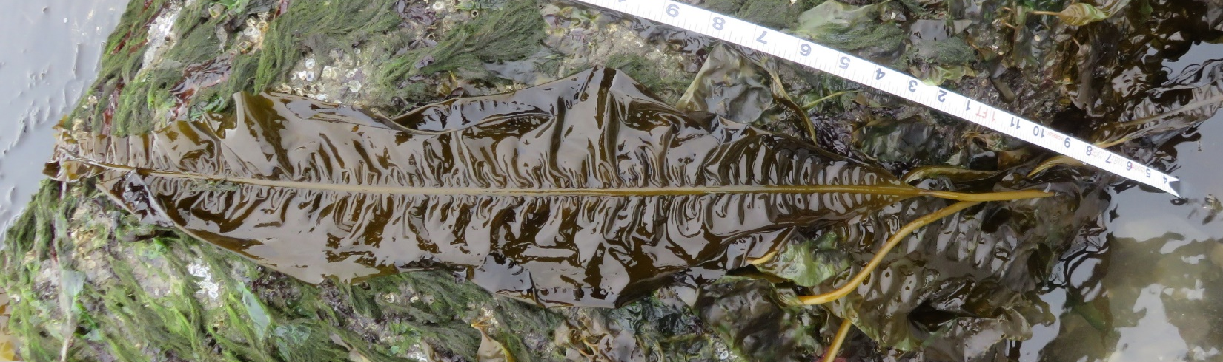
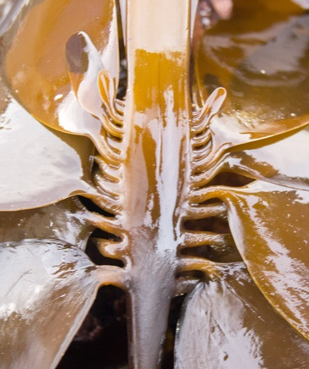
Alaria marginata
Elongated, ruffled blade
Prominent single midrib
Visible holdfast and stipe
Winglike side blades on reproductive individuals
Low intertidal to subtidal
© Judith Elaine Bush

Slide 19
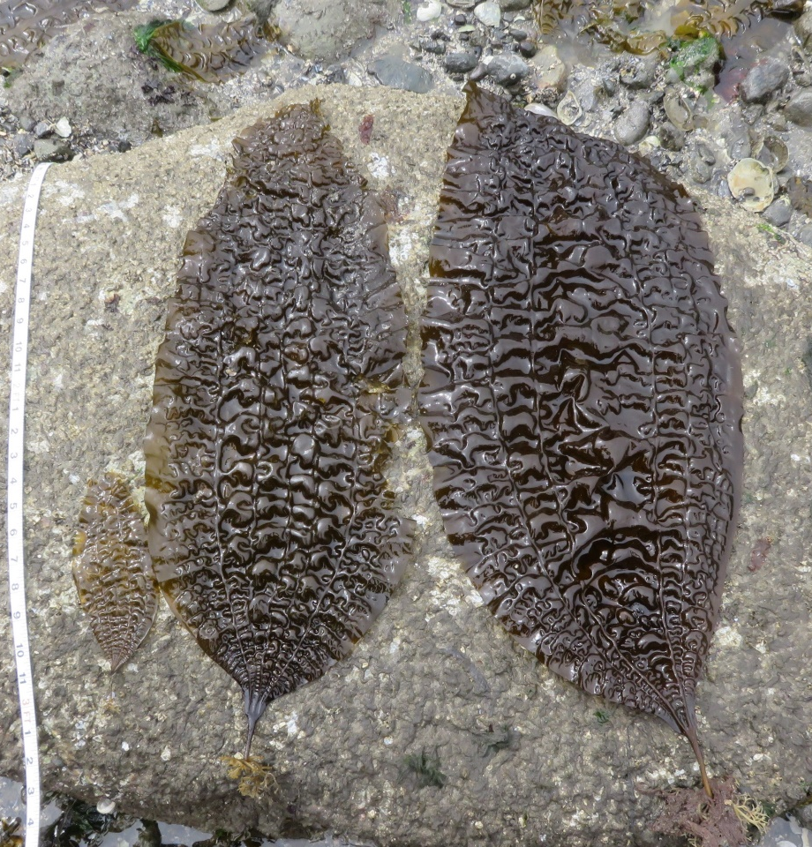
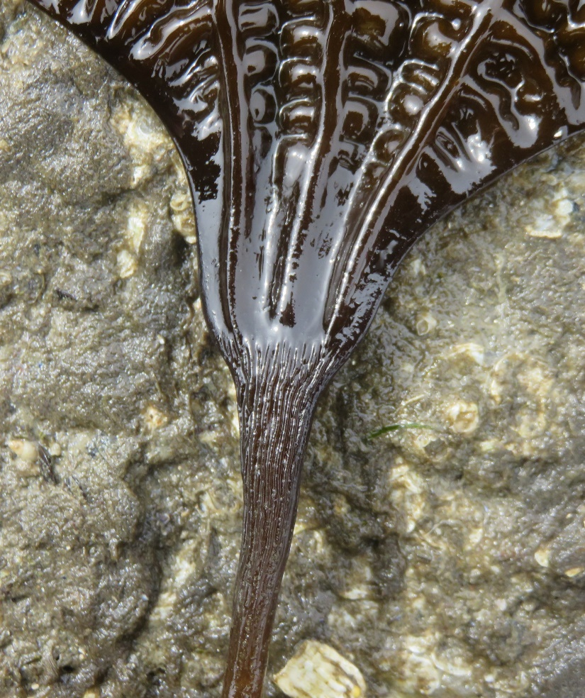
Costaria costata
Large brown puckered blade
5 distinct midribs
Visible holdfast and stipe
Wrinkled stipe
Low intertidal to subtidal

Slide 20
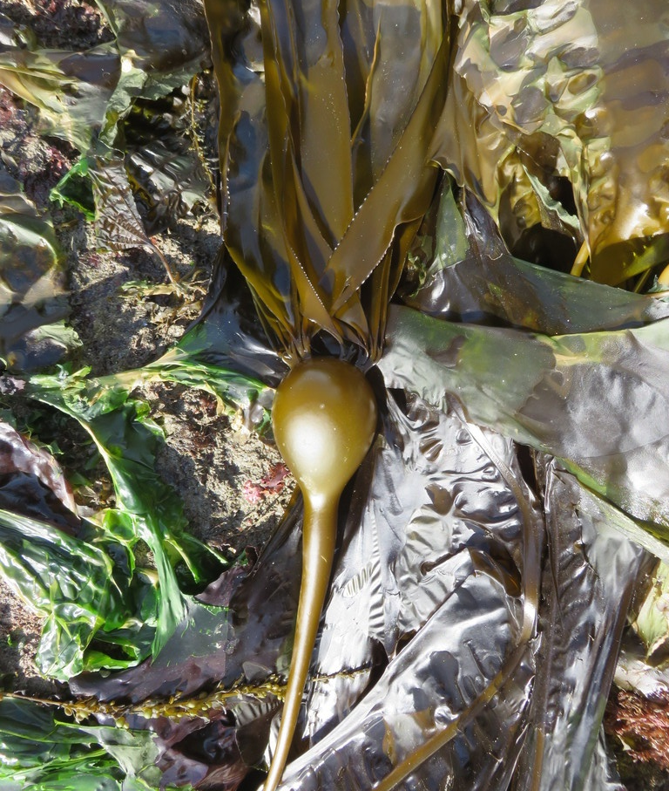
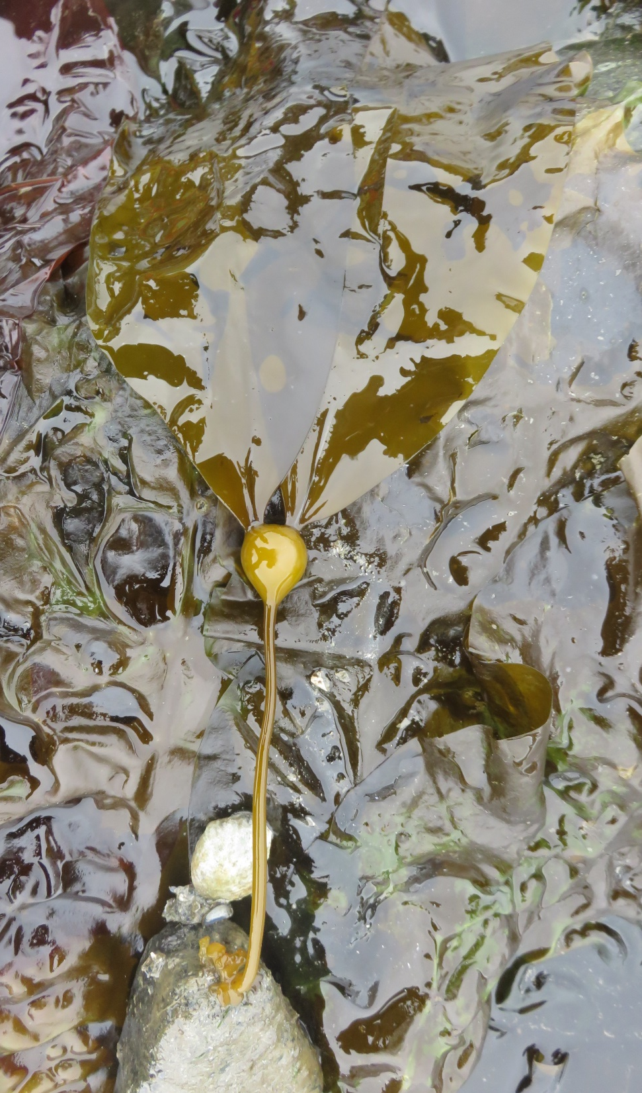
Nereocystis luetkeana
Long stipe with round airbladder
Many smooth blades
Visible holdfast and stipe
No midrib
Low intertidal to subtidal

Slide 21
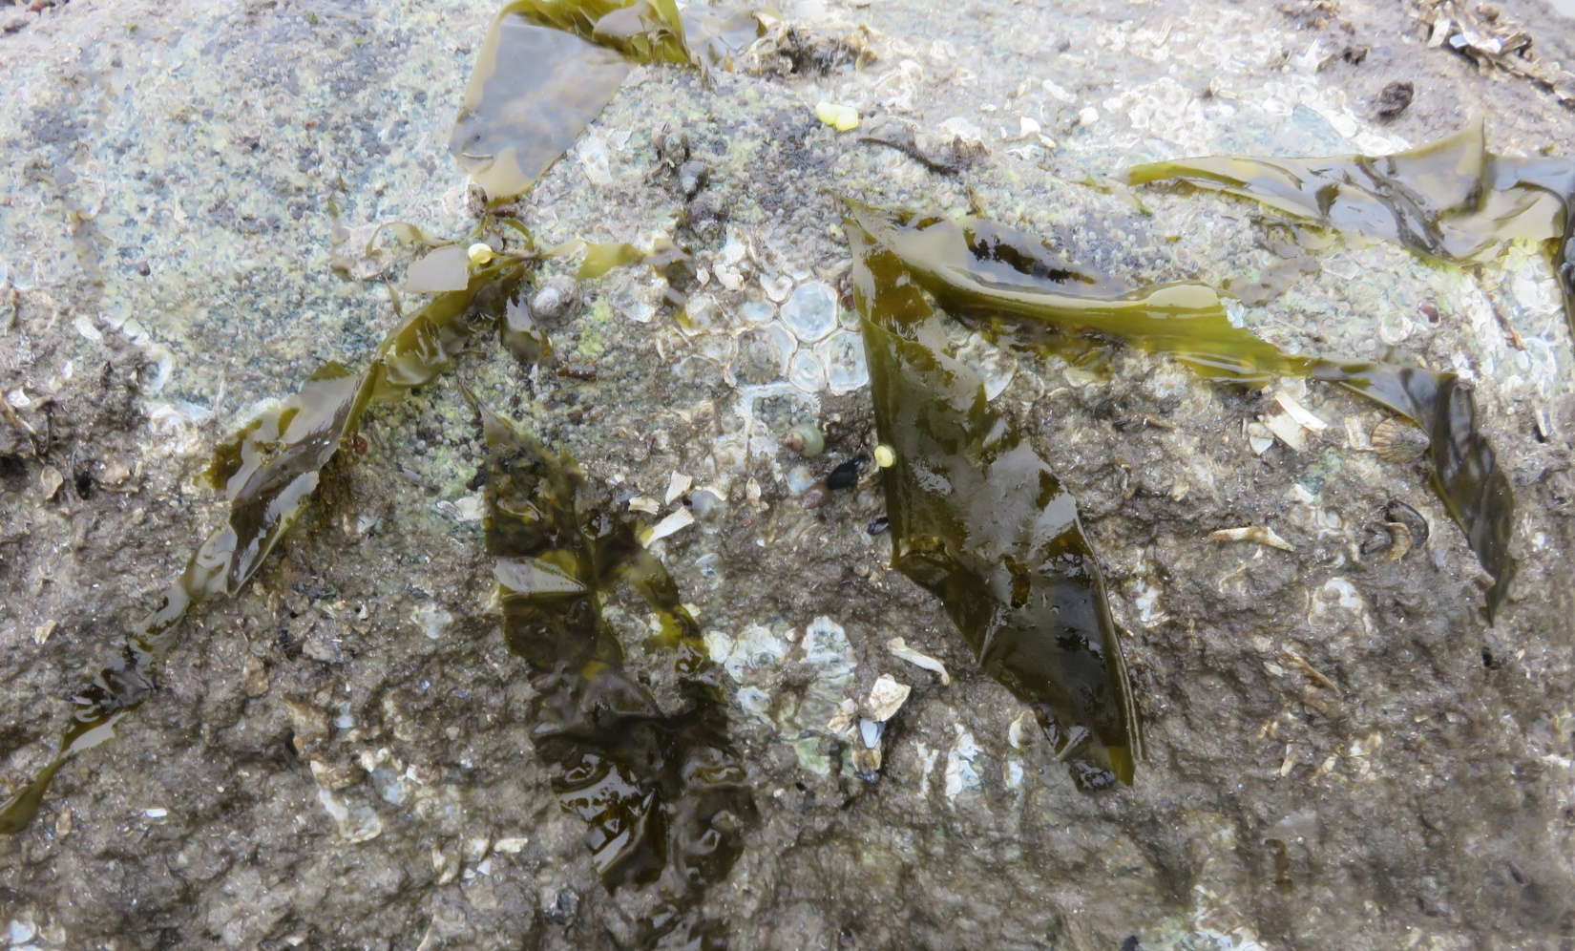
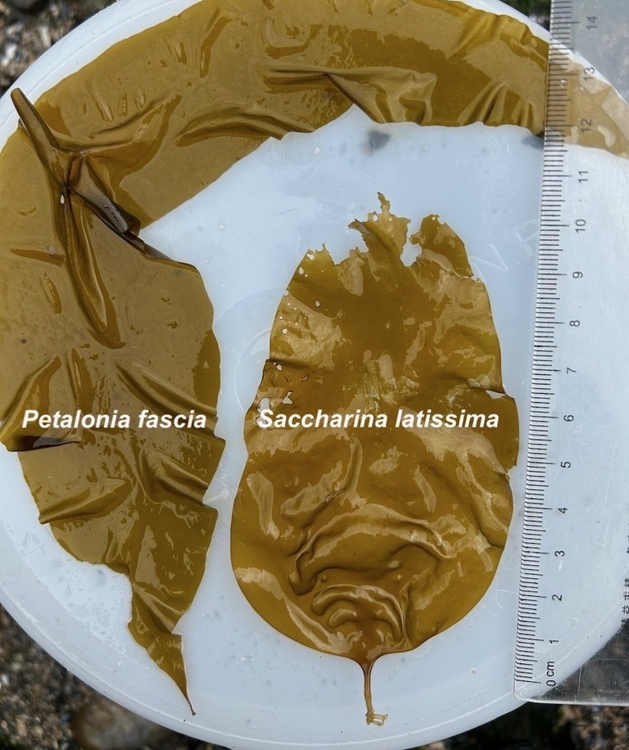
Petalonia fascia
Juvenile
Thin, small (<15cm) brown blades
Tiny, inconspicuous stipe and holdfast
High to mid intertidal
© Bridgette Clarkston

Slide 22
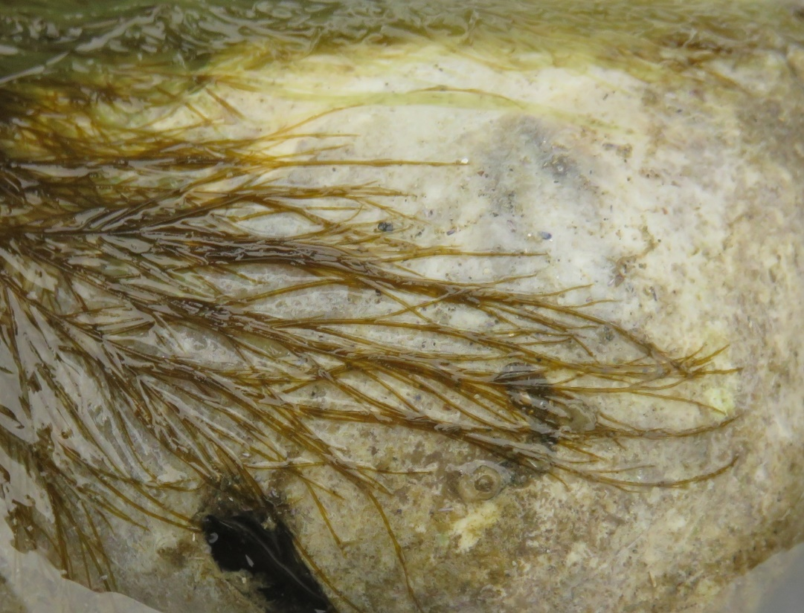
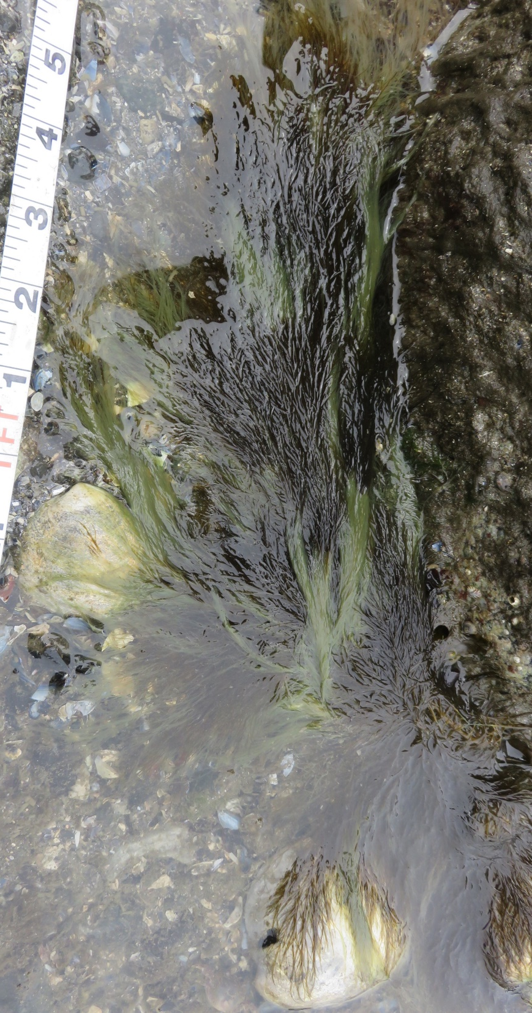


Desmarestia viridis
Feathery brown clumps ~30cm in length
Often has bleached (light green) patches
Opposite branching pattern
Mid to low intertidal

Slide 23
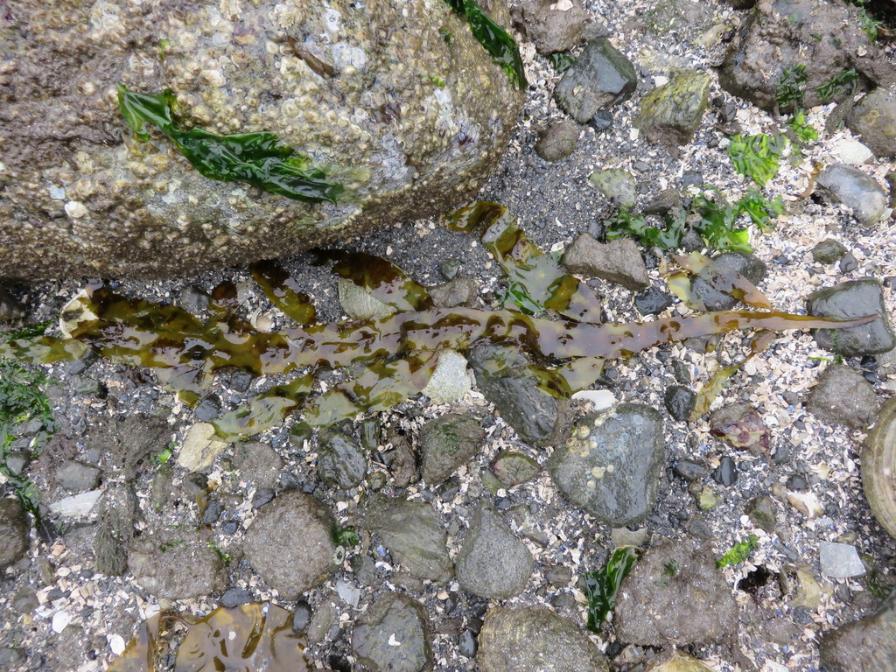
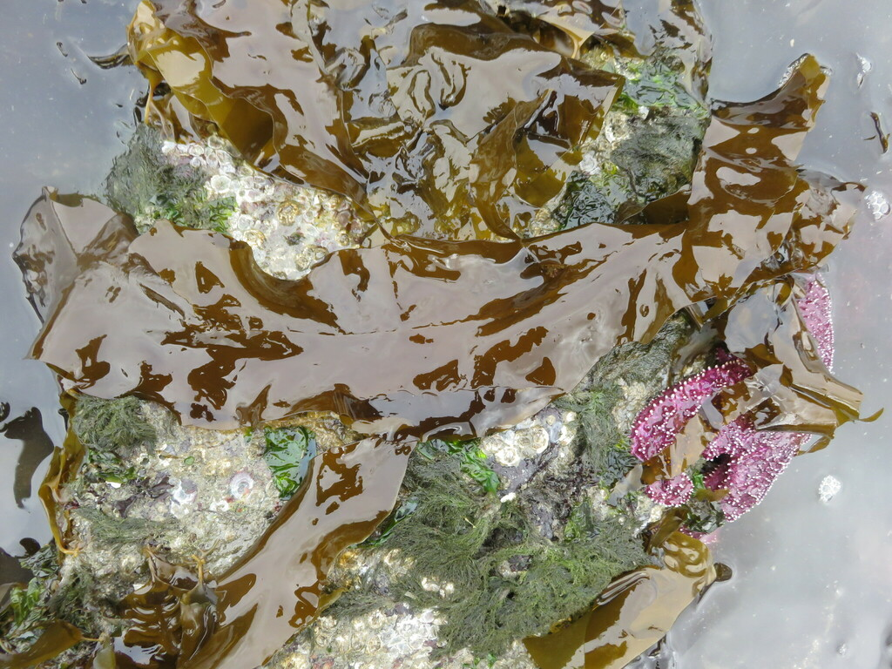
Desmarestia herbacea
Brown, 3+cm wide straplike blades with toothed margins
Side branches grow off the main branch from a narrow junction, 1-2 orders of branching
A faint midrib is present
Low intertidal to subtidal

Slide 24
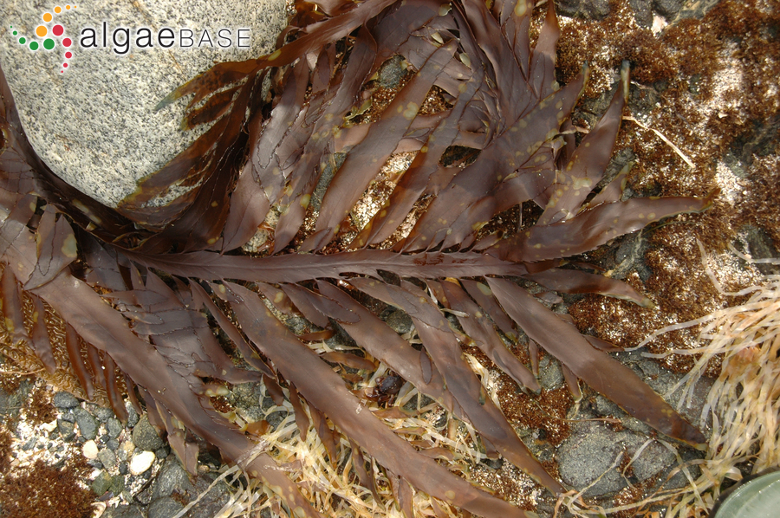
Desmarestia ligulata
Brown, 1-2 cm wide straplike blades with toothed margins
Side branches grow off the main branch from a narrow junction, several orders of branching
A faint midrib is present
Low intertidal to subtidal

Slide 25
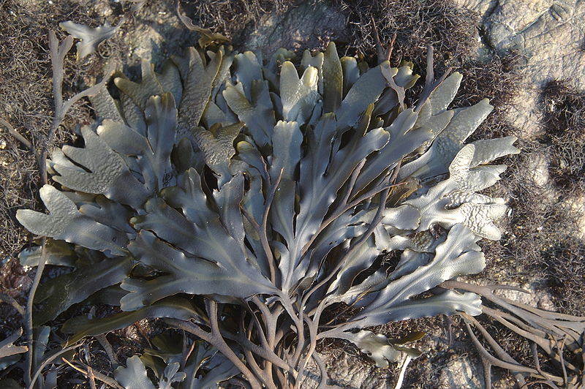
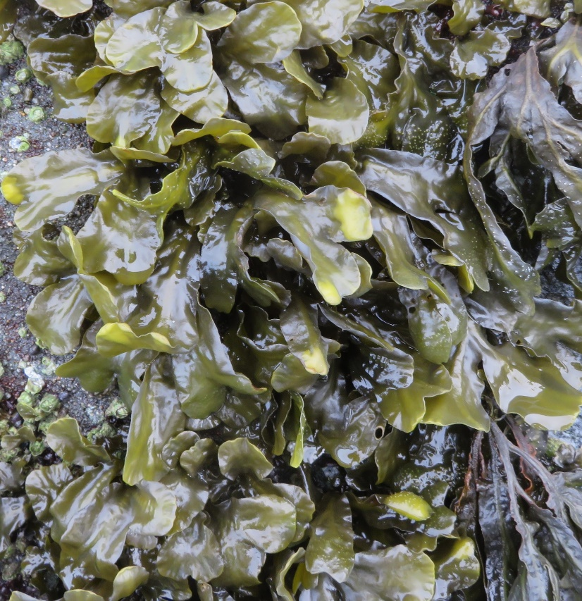
Fucus distichus
Brown, dichotomously branched fans with faint midrib
Warty, swollen tips
Throughout intertidal
© Jerry Kirkhart

Slide 26
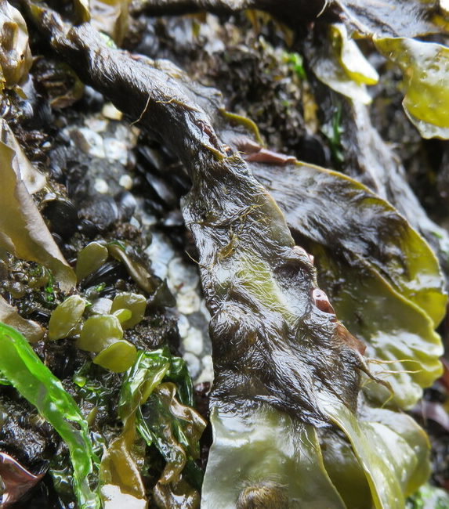
Elachista fucicola
Brown fuzz growing exclusively on older portions of Fucus

Slide 27
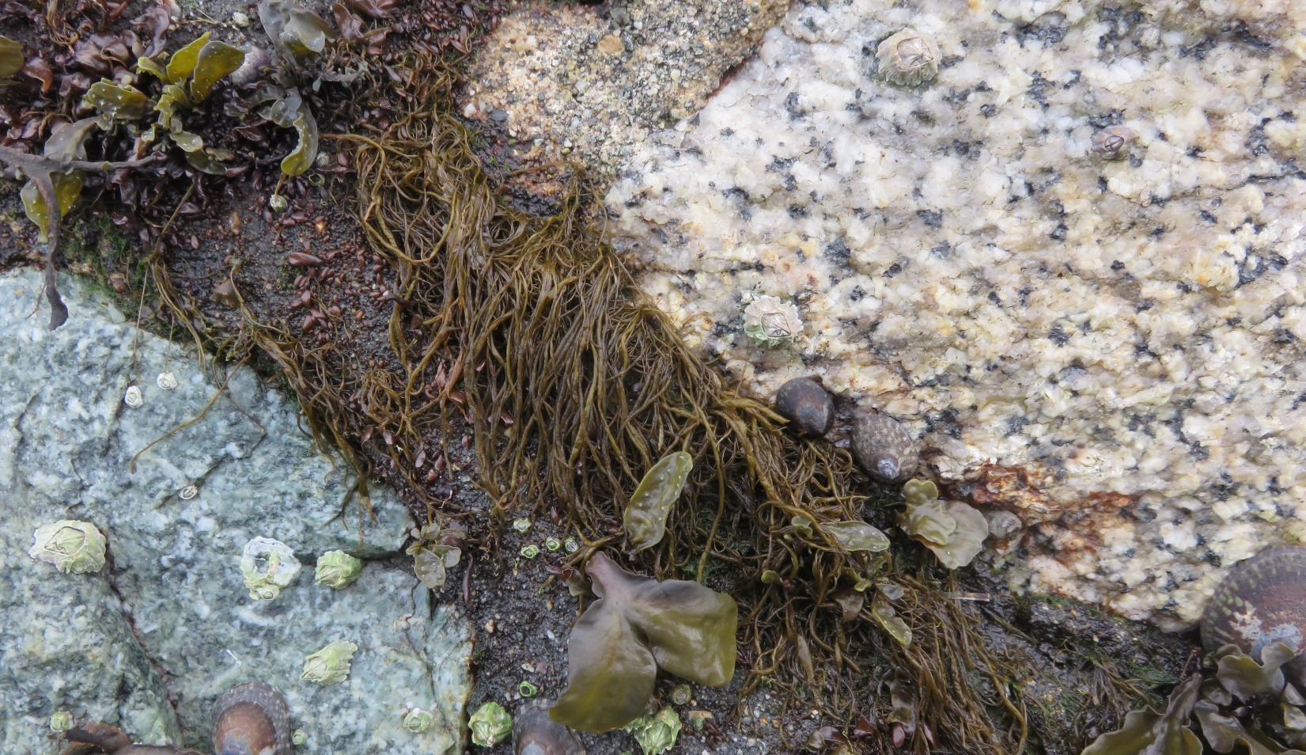
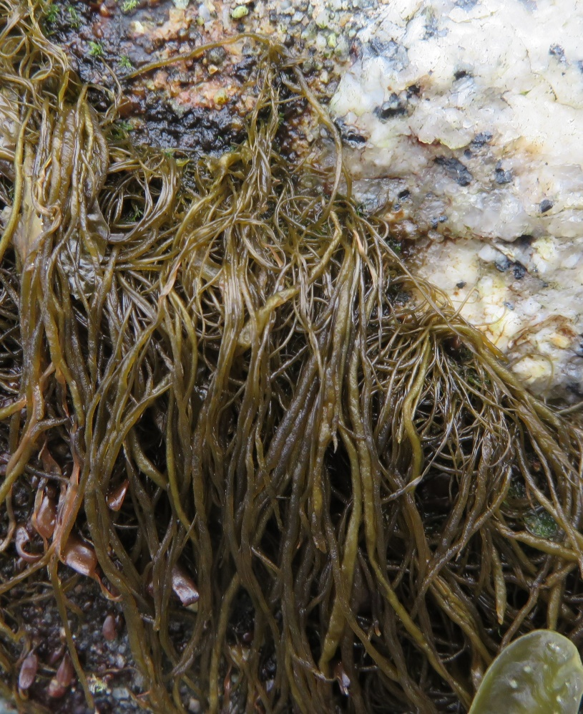
Melanosiphon intestinalis
Yellow-brown thin (<2mm wide) unbranched twisted tubes
No joints High intertidal

Slide 28
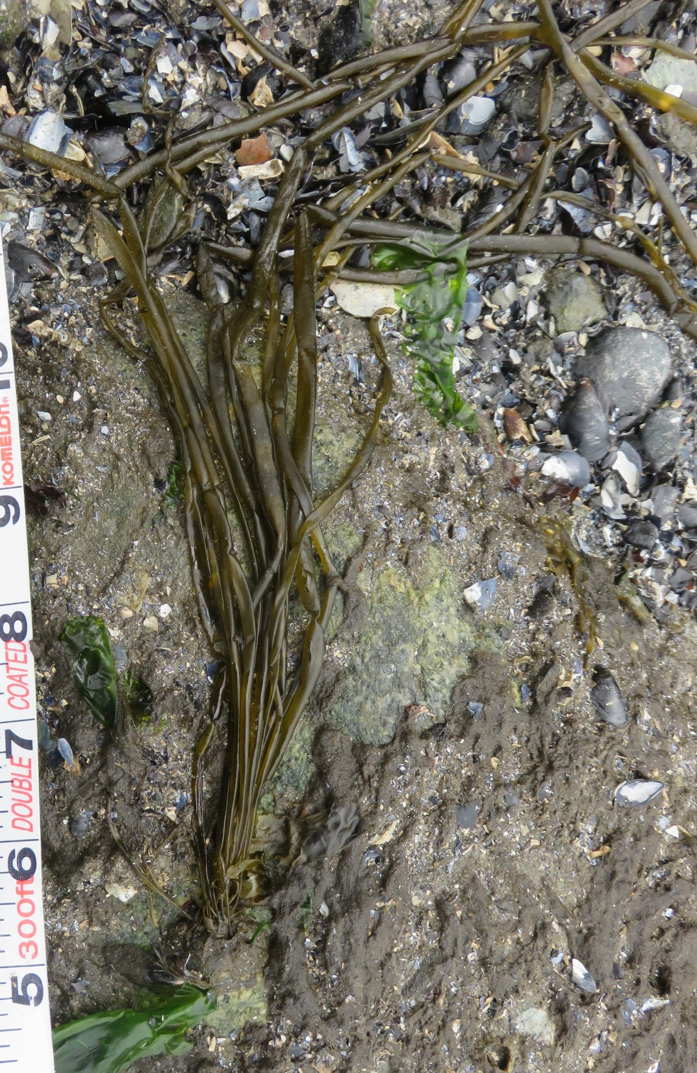
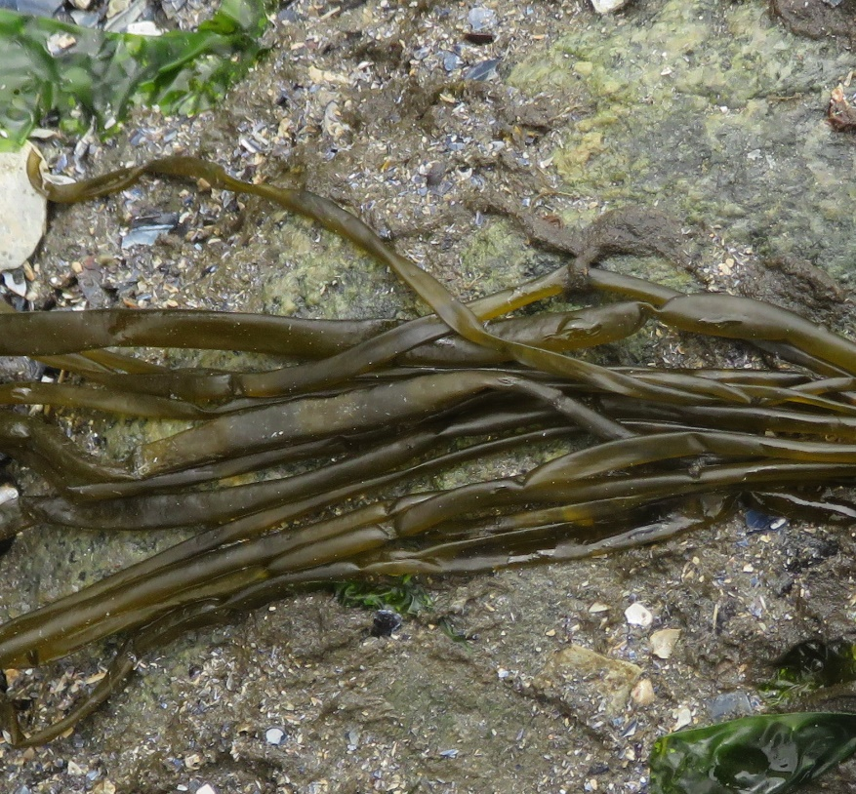
Scytosiphon sp.
Brown tubes around ~0.5m long and up to 4mm wide
Jointed like sausage links
Mid to low intertidal
© Jerry Kirkhart

Slide 29
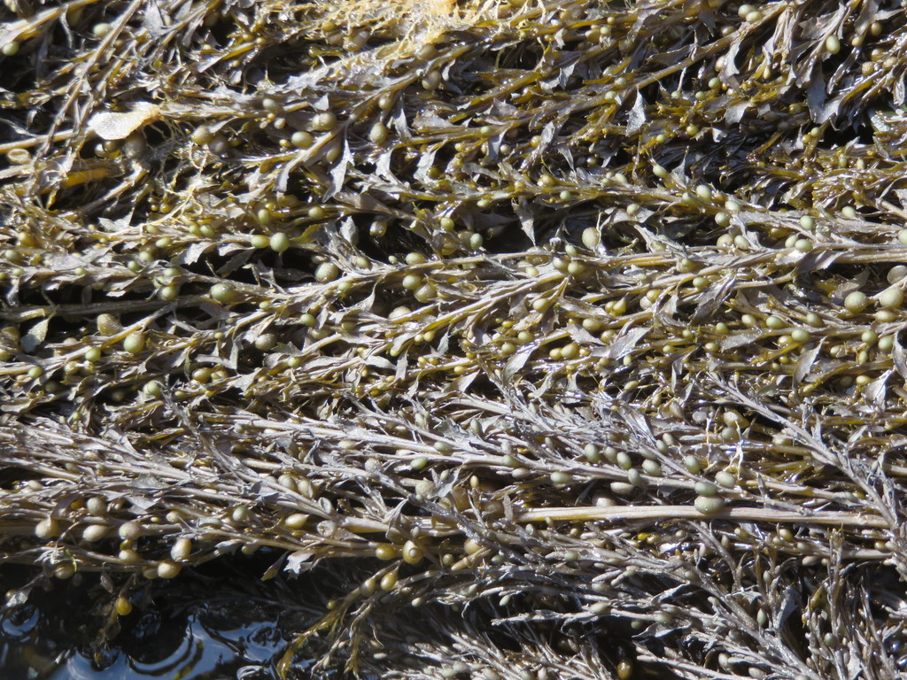

Sargassum muticum
Brown branched strands that can exceed 1m length
Numerous round gas bladders and small blades with toothed margins
Low intertidal to subtidal

